Slide 1
SECURE DATA HIDING IN IMAGE USING STEGANOGRAPHY
CAPSTONE PROJECT
Presented By : Nampally Sai Teja
Student Name : Nampally Sai Teja
College Name & Department : University College Of Engineering
Kakatiya University Kothagudem, Telangana & Btech in Computer Science Engineering

Slide 2
OUTLINE
Problem Statement
Technology used
Wow factor
End users
Result
Conclusion
Git-hub Link
Future scope

Slide 3
Problem Statement
In the modern era, the protection of sensitive data and information is paramount. Traditional methods of data transmission, such as sending data over the internet, expose it to various security risks, including unauthorized access, interception, and tampering. As a result, there is a need for techniques that can securely hide confidential information within seemingly innocent media files, such as images, while ensuring the secrecy and integrity of the transmitted data.
Steganography is one such technique that enables the embedding of secret data within other non-sensitive data (cover data), such as images, audio files, or videos, in a way that prevents detection. Unlike encryption, which only makes the data unreadable without a key, steganography hides the data in such a way that it appears as a normal file to any unauthorized observer. This makes it a vital tool for secure data hiding, ensuring privacy and confidentiality in communication

Slide 4
Technology used
Programming Language:
Python: The primary programming language used for implementing the steganography system.
Libraries and Modules:
OpenCV (cv2)
Platforms:
Python Environment: The code is executed in a Python environment.
IDEs like PyCharm, VS Code
Steganography Techniques

Slide 5
Wow factors
Multi-Layered Security (Steganography + Encryption)
User-Friendly with Simple Interface
Cross-Platform Compatibility
Prevents Unauthorized Access
Hidden Message Cannot be Seen Normally
Works with Any Image File

Slide 6
End users
Individuals (Personal Use)
Businesses and Corporations
Journalists and Whistleblowers
Digital Forensics Experts (Secure Messaging)
Researchers and Academics (Learning Steganography

Slide 7
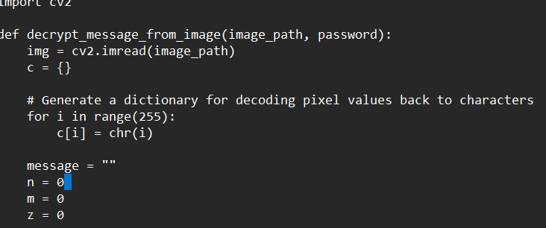
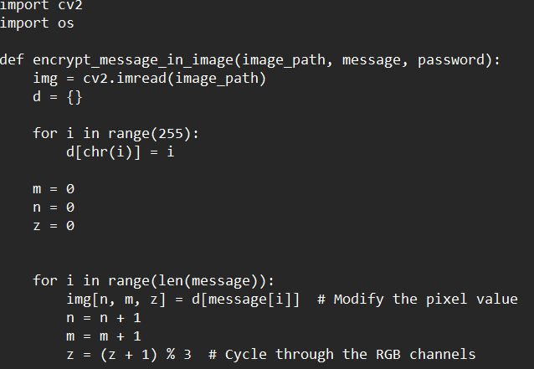

Results

Slide 8
Conclusion
This project provides a secure and efficient way to hide and retrieve sensitive information within images. It enhances privacy and ensures data remains protected from unauthorized access.

Slide 9
GitHub Link
https://github.com/nampallysaiteja-7/Steganography.git

Slide 10
Future scope(optional)
Support for More Image Formats
Improved Security with Advanced Encryption
Mobile App Integration
Cloud-Based Secure Image Storage

Slide 11
THANK YOU

